Slide 1
UNIT IV Classification, Prediction
Prepared by
Lakshmi Priya GG

Slide 2
Overview
Classification methods: Basic concepts-Decision tree- Bayesian Classification- Support Vector Machine- Lazy Learners.
Prediction: Linear and non linear regression, accuracy and Error measures.

Slide 3
Classification vs. Prediction
Classification
  predicts categorical class labels (discrete or nominal)
  classifies data (constructs a model) based on the training set and the values (class labels) in a classifying attribute and uses it in classifying new data
Prediction
  models continuous-valued functions, i.e., predicts unknown or missing values
Typical applications
  Credit approval
  Target marketing
  Medical diagnosis
  Fraud detection

Slide 4
Classification—A Two-Step Process
Model construction: describing a set of predetermined classes
  Each tuple/sample is assumed to belong to a predefined class, as determined by the class label attribute
  The set of tuples used for model construction is training set
  The model is represented as classification rules, decision trees, or mathematical formulae
Model usage: for classifying future or unknown objects
  Estimate accuracy of the model
    The known label of test sample is compared with the classified result from the model
    Accuracy rate is the percentage of test set samples that are correctly classified by the model
    Test set is independent of training set, otherwise over-fitting will occur
  If the accuracy is acceptable, use the model to classify data tuples whose class labels are not known

Slide 5



Process (1): Model Construction
Classification
Algorithms
Training
Data
Classifier
(Model)
IF rank = ‘professor’
OR years > 6
THEN tenured = ‘yes’

Slide 6


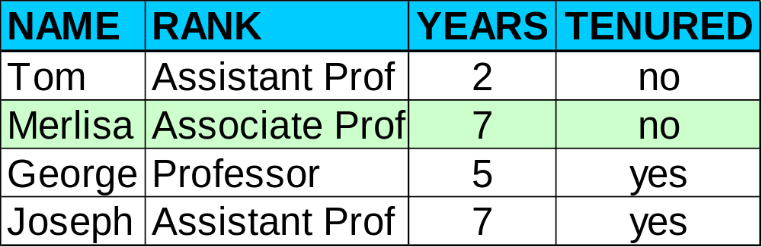

Process (2): Using the Model in Prediction
Classifier
Testing
Data
Unseen Data
(Jeff, Professor, 4)
Tenured?

Slide 7
Supervised vs. Unsupervised Learning
Supervised learning (classification)
  Supervision: The training data (observations, measurements, etc.) are accompanied by labels indicating the class of the observations
  New data is classified based on the training set
Unsupervised learning (clustering)
  The class labels of training data is unknown
  Given a set of measurements, observations, etc. with the aim of establishing the existence of classes or clusters in the data

Slide 8
Issues: Data Preparation
Data cleaning
  Preprocess data in order to reduce noise and handle missing values
Relevance analysis (feature selection)
  Remove the irrelevant or redundant attributes
Data transformation
  Generalize and/or normalize data

Slide 9
Issues: Evaluating Classification Methods
Accuracy
  classifier accuracy: predicting class label
  predictor accuracy: guessing value of predicted attributes
Speed
  time to construct the model (training time)
  time to use the model (classification/prediction time)
Robustness: handling noise and missing values
Scalability: efficiency in disk-resident databases
Interpretability
  understanding and insight provided by the model
Other measures, e.g., goodness of rules, such as decision tree size or compactness of classification rules

Slide 10
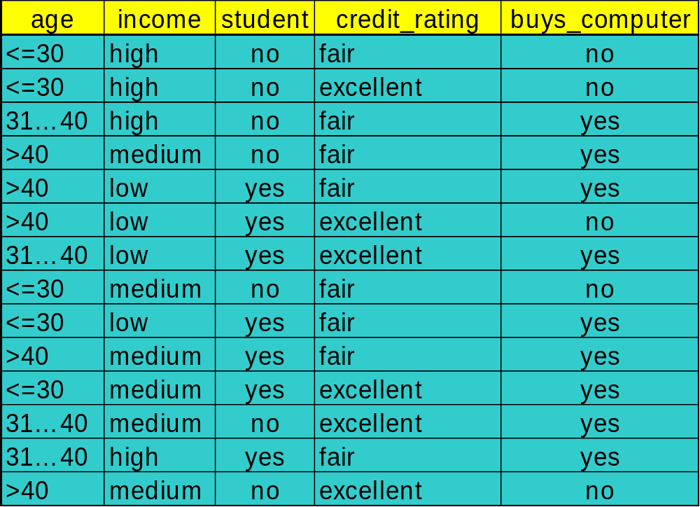
Decision Tree Induction: Training Dataset
This follows an example of Quinlan’s ID3 (Playing Tennis)

Slide 11
Output: A Decision Tree for “buys_computer”
age?
<=30
overcast
>40
31..40
student?
yes
credit rating?
no
yes
excellent
fair
no
yes
no
yes

Slide 12


Classification Example
categorical
categorical
continuous
class
Test
Set
Learn
Classifier
Training
Set
Model

Slide 13
Algorithm for Decision Tree Induction
Basic algorithm (a greedy algorithm)
  Tree is constructed in a top-down recursive divide-and-conquer manner
  At start, all the training examples are at the root
  Attributes are categorical (if continuous-valued, they are discretized in advance)
  Examples are partitioned recursively based on selected attributes
  Test attributes are selected on the basis of a heuristic or statistical measure (e.g., information gain)
Conditions for stopping partitioning
  All samples for a given node belong to the same class
  There are no remaining attributes for further partitioning – majority voting is employed for classifying the leaf
  There are no samples left

Slide 14

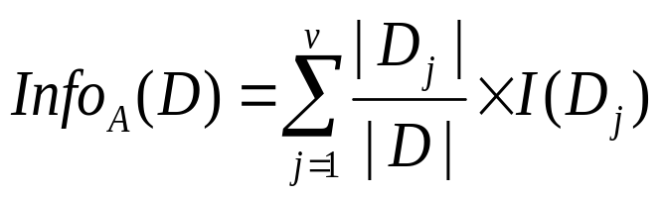

Attribute Selection Measure: Information Gain (ID3/C4.5)
Select the attribute with the highest information gain
Let p_{i} be the probability that an arbitrary tuple in D belongs to class C_{i}, estimated by |C_{i, D}|/|D|
Expected information (entropy) needed to classify a tuple in D:
Information needed (after using A to split D into v partitions) to classify D:
Information gained by branching on attribute A
Notes:
I : the expected information needed to classify a given sample
E (entropy) : expected information based on the partitioning into subsets by A

Slide 15





Attribute Selection: Information Gain
Class P: buys_computer = “yes”
Class N: buys_computer = “no”
means “age <=30” has 5 out of 14 samples, with 2 yes’es and 3 no’s. Hence
Similarly,

Slide 16
Computing Information-Gain for Continuous-Value Attributes
Let attribute A be a continuous-valued attribute
Must determine the best split point for A
  Sort the value A in increasing order
  Typically, the midpoint between each pair of adjacent values is considered as a possible split point
    (a_{i}+a_{i+1})/2 is the midpoint between the values of a_{i} and a_{i+1}
  The point with the minimum expected information requirement for A is selected as the split-point for A
Split:
  D1 is the set of tuples in D satisfying A ≤ split-point, and D2 is the set of tuples in D satisfying A > split-point

Slide 17

Gain Ratio for Attribute Selection (C4.5)
Information gain measure is biased towards attributes with a large number of values
C4.5 (a successor of ID3) uses gain ratio to overcome the problem (normalization to information gain)
  GainRatio(A) = Gain(A)/SplitInfo(A)
Ex.
  gain_ratio(income) = 0.029/0.926 = 0.031
The attribute with the maximum gain ratio is selected as the splitting attribute

Slide 18



Gini index (CART, IBM IntelligentMiner)
If a data set D contains examples from n classes, gini index, gini(D) is defined as
where p_{j} is the relative frequency of class j in D
If a data set D is split on A into two subsets D₁ and D₂, the gini index gini(D) is defined as
Reduction in Impurity:
The attribute provides the smallest gini_{split}(D) (or the largest reduction in impurity) is chosen to split the node (need to enumerate all the possible splitting points for each attribute)

Slide 19


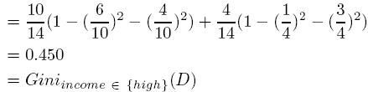
Gini index (CART, IBM IntelligentMiner)
Ex. D has 9 tuples in buys_computer = “yes” and 5 in “no”
Suppose the attribute income partitions D into 10 in D₁: {low, medium} and 4 in D₂
  but gini_{{medium,high}} is 0.30 and thus the best since it is the lowest
All attributes are assumed continuous-valued
May need other tools, e.g., clustering, to get the possible split values
Can be modified for categorical attributes

Slide 20
Comparing Attribute Selection Measures
The three measures, in general, return good results but
  Information gain:
    biased towards multivalued attributes
  Gain ratio:
    tends to prefer unbalanced splits in which one partition is much smaller than the others
  Gini index:
    biased to multivalued attributes
    has difficulty when # of classes is large
    tends to favor tests that result in equal-sized partitions and purity in both partitions

Slide 21
Classification in Large Databases
Classification—a classical problem extensively studied by statisticians and machine learning researchers
Scalability: Classifying data sets with millions of examples and hundreds of attributes with reasonable speed
Why decision tree induction in data mining?
  relatively faster learning speed (than other classification methods)
  convertible to simple and easy to understand classification rules
  can use SQL queries for accessing databases
  comparable classification accuracy with other methods

Slide 22

Presentation of Classification Results

Slide 23

Visualization of a Decision Tree in SGI/MineSet 3.0

Slide 24
Bayesian Classification: Why?
A statistical classifier: performs probabilistic prediction, i.e., predicts class membership probabilities
Foundation: Based on Bayes’ Theorem.
Performance: A simple Bayesian classifier, naïve Bayesian classifier, has comparable performance with decision tree and selected neural network classifiers
Incremental: Each training example can incrementally increase/decrease the probability that a hypothesis is correct — prior knowledge can be combined with observed data
Standard: Even when Bayesian methods are computationally intractable, they can provide a standard of optimal decision making against which other methods can be measured

Slide 25
Bayesian Theorem: Basics
Let X be a data sample (“evidence”): class label is unknown
Let H be a hypothesis that X belongs to class C
Classification is to determine P(H|X), the probability that the hypothesis holds given the observed data sample X
P(H) (prior probability), the initial probability
  E.g., X will buy computer, regardless of age, income, …
P(X): probability that sample data is observed
P(X|H) (posteriori probability), the probability of observing the sample X, given that the hypothesis holds
  E.g., Given that X will buy computer, the prob. that X is 31..40, medium income

Slide 26
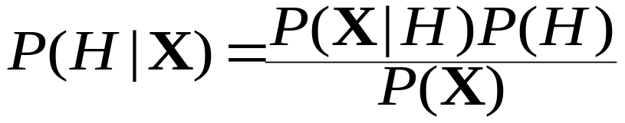
Bayesian Theorem
Given training data X, posteriori probability of a hypothesis H, P(H|X), follows the Bayes theorem
Informally, this can be written as
  posteriori = likelihood x prior/evidence
Predicts X belongs to C₂ iff the probability P(C_{i}|X) is the highest among all the P(C_{k}|X) for all the k classes
Practical difficulty: require initial knowledge of many probabilities, significant computational cost

Slide 27


Towards Naïve Bayesian Classifier
Let D be a training set of tuples and their associated class labels, and each tuple is represented by an n-D attribute vector X = (x₁, x₂, …, x_{n})
Suppose there are m classes C₁, C₂, …, C_{m}.
Classification is to derive the maximum posteriori, i.e., the maximal P(C_{i}|X)
This can be derived from Bayes’ theorem
Since P(X) is constant for all classes, only
  needs to be maximized

Slide 28

Naïve Bayesian Classifier: Training Dataset
Class:
C1:buys_computer = ‘yes’
C2:buys_computer = ‘no’
Data sample
X = (age <=30,
Income = medium,
Student = yes
Credit_rating = Fair)

Slide 29
Naïve Bayesian Classifier: An Example
P(C_{i}): P(buys_computer = “yes”) = 9/14 = 0.643
P(buys_computer = “no”) = 5/14= 0.357
Compute P(X|C_{i}) for each class
P(age = “<=30” | buys_computer = “yes”) = 2/9 = 0.222
P(age = “<= 30” | buys_computer = “no”) = 3/5 = 0.6
P(income = “medium” | buys_computer = “yes”) = 4/9 = 0.444
P(income = “medium” | buys_computer = “no”) = 2/5 = 0.4
P(student = “yes” | buys_computer = “yes) = 6/9 = 0.667
P(student = “yes” | buys_computer = “no”) = 1/5 = 0.2
P(credit_rating = “fair” | buys_computer = “yes”) = 6/9 = 0.667
P(credit_rating = “fair” | buys_computer = “no”) = 2/5 = 0.4
X = (age <= 30 , income = medium, student = yes, credit_rating = fair)
P(X|C_{i}) : P(X|buys_computer = “yes”) = 0.222 x 0.444 x 0.667 x 0.667 = 0.044
P(X|buys_computer = “no”) = 0.6 x 0.4 x 0.2 x 0.4 = 0.019
P(X|C_{i})*P(C_{i}) : P(X|buys_computer = “yes”) * P(buys_computer = “yes”) = 0.028
P(X|buys_computer = “no”) * P(buys_computer = “no”) = 0.007
Therefore, X belongs to class (“buys_computer = yes”)

Slide 30
Naïve Bayesian Classifier: Comments
Advantages
  Easy to implement
  Good results obtained in most of the cases
Disadvantages
  Assumption: class conditional independence, therefore loss of accuracy
  Practically, dependencies exist among variables
    E.g., hospitals: patients: Profile: age, family history, etc.
    Symptoms: fever, cough etc., Disease: lung cancer, diabetes, etc.
    Dependencies among these cannot be modeled by Naïve Bayesian Classifier
How to deal with these dependencies?
  Bayesian Belief Networks

Slide 31
Using IF-THEN Rules for Classification
Represent the knowledge in the form of IF-THEN rules
  R: IF age = youth AND student = yes THEN buys_computer = yes
  Rule antecedent/precondition vs. rule consequent
Assessment of a rule: coverage and accuracy
  n_{covers} = # of tuples covered by R
  n_{correct} = # of tuples correctly classified by R
  coverage(R) = n_{covers} /|D| /* D: training data set */
  accuracy(R) = n_{correct} / n_{covers}
If more than one rule is triggered, need conflict resolution
  Size ordering: assign the highest priority to the triggering rules that has the “toughest” requirement (i.e., with the most attribute test)
  Class-based ordering: decreasing order of prevalence or misclassification cost per class
  Rule-based ordering (decision list): rules are organized into one long priority list, according to some measure of rule quality or by experts

Slide 32
Rule Extraction from a Decision Tree
age?
<=30
31..40
>40
Rules are easier to understand than large trees
One rule is created for each path from the root to a leaf
Each attribute-value pair along a path forms a conjunction: the leaf holds the class prediction
Rules are mutually exclusive and exhaustive
student?
yes
credit rating?
no
yes
excellent
fair
no
yes
no
yes
Example: Rule extraction from our buys_computer decision-tree
  IF age = young AND student = no THEN buys_computer = no
  IF age = young AND student = yes THEN buys_computer = yes
  IF age = mid-age THEN buys_computer = yes
  IF age = old AND credit_rating = excellent THEN buys_computer = yes
  IF age = young AND credit_rating = fair THEN buys_computer = no

Slide 33
Rule Extraction from the Training Data
Sequential covering algorithm: Extracts rules directly from training data
Typical sequential covering algorithms: FOIL, AQ, CN2, RIPPER
Rules are learned sequentially, each for a given class C_{i} will cover many tuples of C_{i} but none (or few) of the tuples of other classes
Steps:
  Rules are learned one at a time
  Each time a rule is learned, the tuples covered by the rules are removed
  The process repeats on the remaining tuples unless termination condition, e.g., when no more training examples or when the quality of a rule returned is below a user-specified threshold
Comp. w. decision-tree induction: learning a set of rules simultaneously

Slide 34


How to Learn-One-Rule?
Star with the most general rule possible: condition = empty
Adding new attributes by adopting a greedy depth-first strategy
  Picks the one that most improves the rule quality
Rule-Quality measures: consider both coverage and accuracy
  Foil-gain (in FOIL & RIPPER): assesses info_gain by extending condition
    It favors rules that have high accuracy and cover many positive tuples
Rule pruning based on an independent set of test tuples
    Pos/neg are # of positive/negative tuples covered by R.
    If FOIL_Prune is higher for the pruned version of R, prune R

Slide 35
Linear Classification
Binary Classification problem
The data above the red line belongs to class ‘x’
The data below red line belongs to class ‘o’
Examples: SVM, Perceptron, Probabilistic Classifiers
x
x
x
x
x
x
x
x
o
x
o
x
o
o
o
o
o
o
o
o
o
o
o

Slide 36
Discriminative Classifiers
Advantages
  prediction accuracy is generally high
    As compared to Bayesian methods – in general
  robust, works when training examples contain errors
  fast evaluation of the learned target function
    Bayesian networks are normally slow
Criticism
  long training time
  difficult to understand the learned function (weights)
    Bayesian networks can be used easily for pattern discovery
  not easy to incorporate domain knowledge
    Easy in the form of priors on the data or distributions

Slide 37
SVM—Support Vector Machines
A new classification method for both linear and nonlinear data
It uses a nonlinear mapping to transform the original training data into a higher dimension
With the new dimension, it searches for the linear optimal separating hyperplane (i.e., “decision boundary”)
With an appropriate nonlinear mapping to a sufficiently high dimension, data from two classes can always be separated by a hyperplane
SVM finds this hyperplane using support vectors (“essential” training tuples) and margins (defined by the support vectors)

Slide 38
SVM—History and Applications
Vapnik and colleagues (1992)—groundwork from Vapnik & Chervonenkis’ statistical learning theory in 1960s
Features: training can be slow but accuracy is high owing to their ability to model complex nonlinear decision boundaries (margin maximization)
Used both for classification and prediction
Applications:
  handwritten digit recognition, object recognition, speaker identification, benchmarking time-series prediction tests

Slide 39
SVM—General Philosophy
Small Margin
Large Margin
Support Vectors

Slide 40


SVM—Margins and Support Vectors

Slide 41
SVM—When Data Is Linearly Separable
m
Let data D be (X₁, y₁), …, (X_{|D|}, y_{|D|}), where X_{i} is the set of training tuples associated with the class labels y_{i}
There are infinite lines (hyperplanes) separating the two classes but we want to find the best one (the one that minimizes classification error on unseen data)
SVM searches for the hyperplane with the largest margin, i.e., maximum marginal hyperplane (MMH)

Slide 42
SVM—Linearly Separable
A separating hyperplane can be written as
    W ● X + b = 0
  where W={w₁, w₂, …, w_{n}} is a weight vector and b a scalar (bias)
For 2-D it can be written as
    w₀ + w₁ x₁ + w₂ x₂ = 0
The hyperplane defining the sides of the margin:
    H₁: w₀ + w₁ x₁ + w₂ x₂ ≥ 1 for y_{i} = +1, and
    H₂: w₀ + w₁ x₁ + w₂ x₂ ≤ – 1 for y_{i} = –1
Any training tuples that fall on hyperplanes H₁ or H₂ (i.e., the
sides defining the margin) are support vectors
This becomes a constrained (convex) quadratic optimization problem: Quadratic objective function and linear constraints → Quadratic Programming (QP) → Lagrangian multipliers

Slide 43
Why Is SVM Effective on High Dimensional Data?
The complexity of trained classifier is characterized by the # of support vectors rather than the dimensionality of the data
The support vectors are the essential or critical training examples —they lie closest to the decision boundary (MMH)
If all other training examples are removed and the training is repeated, the same separating hyperplane would be found
The number of support vectors found can be used to compute an (upper) bound on the expected error rate of the SVM classifier, which is independent of the data dimensionality
Thus, an SVM with a small number of support vectors can have good generalization, even when the dimensionality of the data is high

Slide 44


SVM—Linearly Inseparable
Transform the original input data into a higher dimensional space
Search for a linear separating hyperplane in the new space

Slide 45
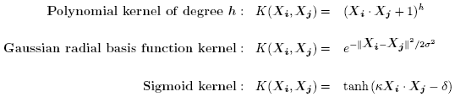
SVM—Kernel functions
Instead of computing the dot product on the transformed data tuples, it is mathematically equivalent to instead applying a kernel function K(X_{i}, X_{j}) to the original data, i.e., K(X_{i}, X_{j}) = Φ(X_{i}) Φ(X_{j})
Typical Kernel Functions
SVM can also be used for classifying multiple (> 2) classes and for regression analysis (with additional user parameters)

Slide 46
Lazy vs. Eager Learning
Lazy vs. eager learning
  Lazy learning (e.g., instance-based learning): Simply stores training data (or only minor processing) and waits until it is given a test tuple
  Eager learning (the above discussed methods): Given a set of training set, constructs a classification model before receiving new (e.g., test) data to classify
Lazy: less time in training but more time in predicting
Accuracy
  Lazy method effectively uses a richer hypothesis space since it uses many local linear functions to form its implicit global approximation to the target function
  Eager: must commit to a single hypothesis that covers the entire instance space

Slide 47
Lazy Learner: Instance-Based Methods
Instance-based learning:
  Store training examples and delay the processing (“lazy evaluation”) until a new instance must be classified
Typical approaches
  k-nearest neighbor approach
    Instances represented as points in a Euclidean space.
  Locally weighted regression
    Constructs local approximation
  Case-based reasoning
    Uses symbolic representations and knowledge-based inference

Slide 48
The k-Nearest Neighbor Algorithm
All instances correspond to points in the n-D space
The nearest neighbor are defined in terms of Euclidean distance, dist(X₁, X₂)
Target function could be discrete- or real- valued
For discrete-valued, k-NN returns the most common value among the k training examples nearest to x_{q}
Vonoroi diagram: the decision surface induced by 1-NN for a typical set of training examples
_
.
_
_
.
+
_
.
+
.
.
_
x_{q}
+
_
.
+

Slide 49
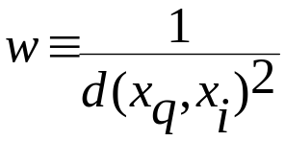
Discussion on the k-NN Algorithm
k-NN for real-valued prediction for a given unknown tuple
  Returns the mean values of the k nearest neighbors
Distance-weighted nearest neighbor algorithm
  Weight the contribution of each of the k neighbors according to their distance to the query x_{q}
    Give greater weight to closer neighbors
Robust to noisy data by averaging k-nearest neighbors
Curse of dimensionality: distance between neighbors could be dominated by irrelevant attributes
  To overcome it, axes stretch or elimination of the least relevant attributes

Slide 50
Case-Based Reasoning (CBR)
CBR: Uses a database of problem solutions to solve new problems
Store symbolic description (tuples or cases)—not points in a Euclidean space
Applications: Customer-service (product-related diagnosis), legal ruling
Methodology
  Instances represented by rich symbolic descriptions (e.g., function graphs)
  Search for similar cases, multiple retrieved cases may be combined
  Tight coupling between case retrieval, knowledge-based reasoning, and problem solving
Challenges
  Find a good similarity metric
  Indexing based on syntactic similarity measure, and when failure, backtracking, and adapting to additional cases

Slide 51
Genetic Algorithms (GA)
Genetic Algorithm: based on an analogy to biological evolution
An initial population is created consisting of randomly generated rules
  Each rule is represented by a string of bits
  E.g., if A₁ and ¬A₂ then C₂ can be encoded as 100
  If an attribute has k > 2 values, k bits can be used
Based on the notion of survival of the fittest, a new population is formed to consist of the fittest rules and their offsprings
The fitness of a rule is represented by its classification accuracy on a set of training examples
Offsprings are generated by crossover and mutation
The process continues until a population P evolves when each rule in P satisfies a prespecified threshold
Slow but easily parallelizable

Slide 52

Rough Set Approach
Rough sets are used to approximately or “roughly” define equivalent classes
A rough set for a given class C is approximated by two sets: a lower approximation (certain to be in C) and an upper approximation (cannot be described as not belonging to C)
Finding the minimal subsets (reducts) of attributes for feature reduction is NP-hard but a discernibility matrix (which stores the differences between attribute values for each pair of data tuples) is used to reduce the computation intensity

Slide 53

Fuzzy Set Approaches
Fuzzy logic uses truth values between 0.0 and 1.0 to represent the degree of membership (such as using fuzzy membership graph)
Attribute values are converted to fuzzy values
  e.g., income is mapped into the discrete categories {low, medium, high} with fuzzy values calculated
For a given new sample, more than one fuzzy value may apply
Each applicable rule contributes a vote for membership in the categories
Typically, the truth values for each predicted category are summed, and these sums are combined

Slide 54
Prediction

Slide 55
What Is Prediction?
(Numerical) prediction is similar to classification
  construct a model
  use model to predict continuous or ordered value for a given input
Prediction is different from classification
  Classification refers to predict categorical class label
  Prediction models continuous-valued functions
Major method for prediction: regression
  model the relationship between one or more independent or predictor variables and a dependent or response variable
Regression analysis
  Linear and multiple regression
  Non-linear regression
  Other regression methods: generalized linear model, Poisson regression, log-linear models, regression trees

Slide 56
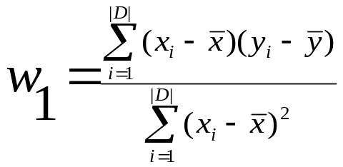
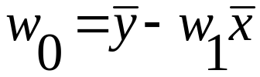
Linear Regression
Linear regression: involves a response variable y and a single predictor variable x
    y = w₀ + w₁ x
  where w₀ (y-intercept) and w₁ (slope) are regression coefficients
Method of least squares: estimates the best-fitting straight line
Multiple linear regression: involves more than one predictor variable
  Training data is of the form (X₁, y₁), (X₂, y₂),…, (X_{|D|}, y_{|D|})
  Ex. For 2-D data, we may have: y = w₀ + w₁ x₁+ w₂ x₂
  Solvable by extension of least square method or using SAS, S-Plus
  Many nonlinear functions can be transformed into the above

Slide 57
Nonlinear Regression
Some nonlinear models can be modeled by a polynomial function
A polynomial regression model can be transformed into linear regression model. For example,
    y = w₀ + w₁ x + w₂ x² + w₃ x³
  convertible to linear with new variables: x₂ = x², x₃= x³
    y = w₀ + w₁ x + w₂ x₂ + w₃ x₃
Other functions, such as power function, can also be transformed to linear model
Some models are intractable nonlinear (e.g., sum of exponential terms)
  possible to obtain least square estimates through extensive calculation on more complex formulae

Slide 58
Other Regression-Based Models
Generalized linear model:
  Foundation on which linear regression can be applied to modeling categorical response variables
  Variance of y is a function of the mean value of y, not a constant
  Logistic regression: models the prob. of some event occurring as a linear function of a set of predictor variables
  Poisson regression: models the data that exhibit a Poisson distribution
Log-linear models: (for categorical data)
  Approximate discrete multidimensional prob. distributions
  Also useful for data compression and smoothing
Regression trees and model trees
  Trees to predict continuous values rather than class labels

Slide 59
Regression Trees and Model Trees
Regression tree: proposed in CART system (Breiman et al. 1984)
  CART: Classification And Regression Trees
  Each leaf stores a continuous-valued prediction
  It is the average value of the predicted attribute for the training tuples that reach the leaf
Model tree: proposed by Quinlan (1992)
  Each leaf holds a regression model—a multivariate linear equation for the predicted attribute
  A more general case than regression tree
Regression and model trees tend to be more accurate than linear regression when the data are not represented well by a simple linear model

Slide 60
Predictive Modeling in Multidimensional Databases
Predictive modeling: Predict data values or construct generalized linear models based on the database data
One can only predict value ranges or category distributions
Method outline:
  Minimal generalization
  Attribute relevance analysis
  Generalized linear model construction
  Prediction
Determine the major factors which influence the prediction
  Data relevance analysis: uncertainty measurement, entropy analysis, expert judgement, etc.
Multi-level prediction: drill-down and roll-up analysis

Slide 61
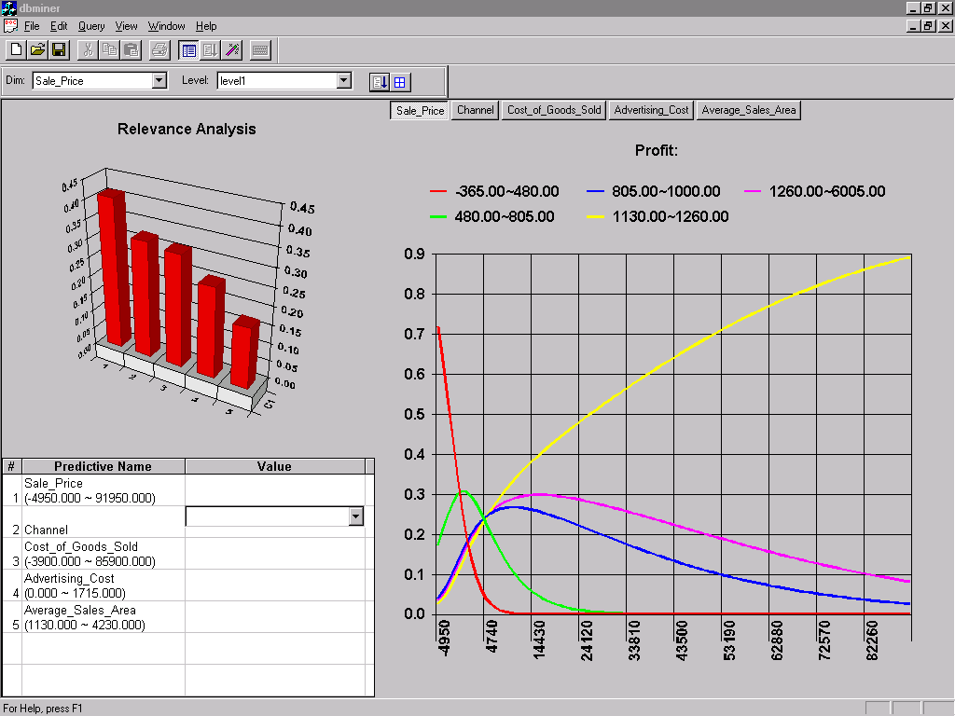
Prediction: Numerical Data

Slide 62
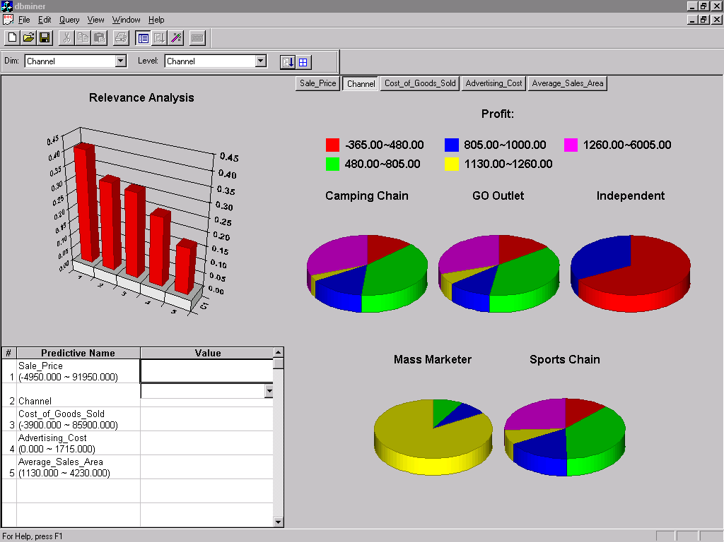
Prediction: Categorical Data

Slide 63
Classifier Accuracy Measures
 | C₁ | C₂
C₁ | True positive | False negative
C₂ | False positive | True negative
classes | buy_computer = yes | buy_computer = no | total | recognition(%)
buy_computer = yes | 6954 | 46 | 7000 | 99.34
buy_computer = no | 412 | 2588 | 3000 | 86.27
total | 7366 | 2634 | 10000 | 95.52
Accuracy of a classifier M, acc(M): percentage of test set tuples that are correctly classified by the model M
  Error rate (misclassification rate) of M = 1 – acc(M)
  Given m classes, CM_{i,j}, an entry in a confusion matrix, indicates # of tuples in class i that are labeled by the classifier as class j
Alternative accuracy measures (e.g., for cancer diagnosis)
  sensitivity = t-pos/pos /* true positive recognition rate */
  specificity = t-neg/neg /* true negative recognition rate */
  precision = t-pos/(t-pos + f-pos)
  accuracy = sensitivity * pos/(pos + neg) + specificity * neg/(pos + neg)
  This model can also be used for cost-benefit analysis

Slide 64




Predictor Error Measures
Measure predictor accuracy: measure how far off the predicted value is from the actual known value
Loss function: measures the error betw. y_{i} and the predicted value y_{i}’
  Absolute error: | y_{i} – y_{i}’|
  Squared error: (y_{i} – y_{i}’)²
Test error (generalization error): the average loss over the test set
  Mean absolute error: Mean squared error:
  Relative absolute error: Relative squared error:
  The mean squared-error exaggerates the presence of outliers
  Popularly use (square) root mean-square error, similarly, root relative squared error

Slide 65
Evaluating the Accuracy of a Classifier or Predictor (I)
Holdout method
  Given data is randomly partitioned into two independent sets
    Training set (e.g., 2/3) for model construction
    Test set (e.g., 1/3) for accuracy estimation
  Random sampling: a variation of holdout
    Repeat holdout k times, accuracy = avg. of the accuracies obtained
Cross-validation (k-fold, where k = 10 is most popular)
  Randomly partition the data into k mutually exclusive subsets, each approximately equal size
  At i-th iteration, use D_{i} as test set and others as training set
  Leave-one-out: k folds where k = # of tuples, for small sized data
  Stratified cross-validation: folds are stratified so that class dist. in each fold is approx. the same as that in the initial data

Slide 66
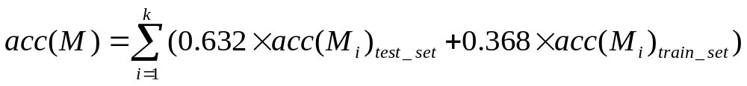
Evaluating the Accuracy of a Classifier or Predictor (II)
Bootstrap
  Works well with small data sets
  Samples the given training tuples uniformly with replacement
    i.e., each time a tuple is selected, it is equally likely to be selected again and re-added to the training set
Several boostrap methods, and a common one is .632 boostrap
  Suppose we are given a data set of d tuples. The data set is sampled d times, with replacement, resulting in a training set of d samples. The data tuples that did not make it into the training set end up forming the test set. About 63.2% of the original data will end up in the bootstrap, and the remaining 36.8% will form the test set (since (1 – 1/d)^{d} ≈ e⁻¹ = 0.368)
  Repeat the sampling procedue k times, overall accuracy of the model:

Slide 67

Model Selection: ROC Curves
ROC (Receiver Operating Characteristics) curves: for visual comparison of classification models
Originated from signal detection theory
Shows the trade-off between the true positive rate and the false positive rate
The area under the ROC curve is a measure of the accuracy of the model
Rank the test tuples in decreasing order: the one that is most likely to belong to the positive class appears at the top of the list
The closer to the diagonal line (i.e., the closer the area is to 0.5), the less accurate is the model
Vertical axis represents the true positive rate
Horizontal axis rep. the false positive rate
The plot also shows a diagonal line
A model with perfect accuracy will have an area of 1.0

Slide 68
Summary (I)
Classification and prediction are two forms of data analysis that can be used to extract models describing important data classes or to predict future data trends.
Effective and scalable methods have been developed for decision trees induction, Naive Bayesian classification, Bayesian belief network, rule-based classifier, Backpropagation, Support Vector Machine (SVM), associative classification, nearest neighbor classifiers, and case-based reasoning, and other classification methods such as genetic algorithms, rough set and fuzzy set approaches.
Linear, nonlinear, and generalized linear models of regression can be used for prediction. Many nonlinear problems can be converted to linear problems by performing transformations on the predictor variables. Regression trees and model trees are also used for prediction.

